Slide 1
Introduction to Cancer Immunotherapy
Qi Xie PhD
1-18-2019

Slide 2
Cancer: Immune Evasion

Slide 3
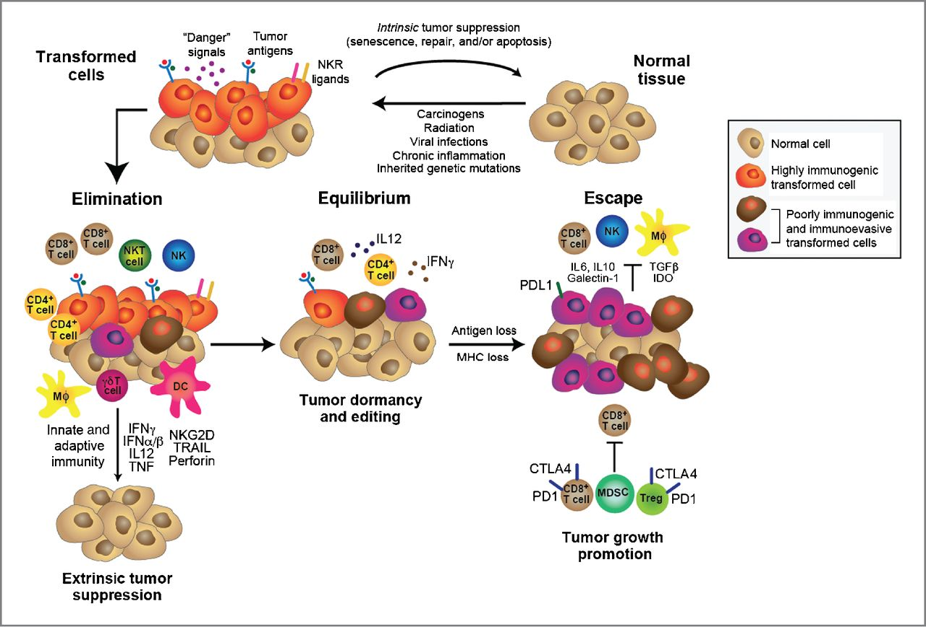
Cancer: Immune Evasion

Slide 4
History of Cancer Immunotherapy

Slide 5
Cancer Immunotherapy
1.Immune checkpoint blockade (Wenbing)
2.Oncolytics Virus(Wenbing)
3. CAR-T cell adoptive immunotherapy
4. Cancer Vaccines and tumor Neoantigens

Slide 6
CAR-T cell immunotherapy
Chimeric Antigen Receptor (CAR)-T cell

Slide 7
CAR-T cell Activation

Slide 8
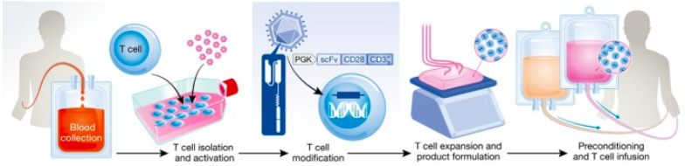
CAR-T cell WorkFlow

Slide 9
CAR-T cell immunotherapy

Slide 10
CAR-T cell immunotherapy

Slide 11
CAR-T cell immunotherapy

Slide 12
CAR-T cell immunotherapy

Slide 13
CAR-T cell immunotherapy
Cytokine Release Syndrome
IL6

Slide 14
CAR-T cell immunotherapy
Approaches to improve CAR-T therapy

Slide 15
Cancer Vaccines and tumor Neoantigens

Slide 16
Cancer Vaccines and tumor Neoantigens
1. cancer vaccines against viral antigens
2. cancer vaccines against nonviral antigens

Slide 17
Cancer Vaccines and tumor Neoantigens
Cancer Vaccines against viral antigens

Slide 18
Cancer Vaccines and tumor Neoantigens
Cancer Vaccines against nonviral antigens
Tumor Specific Antigens (TSAs) are antigens that are not encoded in the normal host genome
Tumor Associated Antigens(TAAs) include proteins encoded in the normal genome and may be either normal differentiation antigens or aberrantly expressed normal proteins
Neoantigens are antigens generated by somatic mutations that can be recognized by the host immune system.(Part of TSAs)

Slide 19
Cancer Vaccines and tumor Neoantigens
Neoantigens specific therapy

Slide 20
Cancer Vaccines and tumor Neoantigens

Slide 21
Cancer Vaccines and tumor Neoantigens

Slide 22
Cancer Vaccines and tumor Neoantigens

Slide 23
Cancer Vaccines and tumor Neoantigens

Slide 25
Thank you!

